Slide 2


Presenter
Presenter
James Nguyen
Info Safe
Pen Tester
Email: jnguyen@infosafe.com
Stephanie Ortega
Info Safe
Pen Tester
Email: sortega@infosafe.com

Slide 3
Researching the Inner Works of Password Cracking Tools
By: James Nguyen, Stephanie Ortega
Notes:
This presentation is called "Researching the Inner Works of Password Cracking Tools”
Reason why we choose this topic: We were curious about other methods of password cracking tools and wanted to research them to see how in the world of cybersecurity we could learn how to protect ourselves from having our passwords cracked with these tools.

Slide 4

Different Password Crackers & Techniques
Brute Force
Rainbow Table
Dictionary
Hybrid: Brute Force and Dictionary
Notes:
There are a few different techniques that are traditionally used with these tools. There are brute force attacks, rainbow table attacks, dictionary attacks, and hybrid attacks that combine both brute force as well as dictionary attacks.
Today, we’ll be talking about 4 different tools used to crack passwords:
Hydra
Cain & Abel
RainbowCrack
JohnTheRipper
As well as doing a demonstration into how one of them work.

Slide 5

Hydra
Fast and flexible
Primarily uses brute force dictionary-based attacks (Hybrid)
Very effective against remote authentication services
Most popular Operating Systems:
Windows, Linux/Unix, MacOs
Supports a wide range of protocols:
TELNET, FTP, HTTP, HTTPS, SNMAP, IMAP, POP3
Notes:
When to use:
Hydra is an online brute forcing tool meaning that it utilizes online network protocols such as ssh and RDP
So if you need an offline tool to for example crack a Linux password shadow file you’d require a different tool such as hashcat or John the Ripper

Slide 6
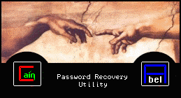
Cain and Abel
Password recovery tool for Windows OS
Can be used by:
Sniffing the network, deciphering passwords using Dictionary, brute force
Also recovers wireless network keys
Notes:
Cain and Abel is a very powerful Windows only password recovery tool.
Who should use this tool?:
Network administrators, teachers, professional penetration testers, security consultants/professionals, forensic staff, and security software vendors
It was created to be a password recovery tool that uses brute force, dictionary, as well as cryptanalysis attacks.
Although it is not just limited to password cracking, it is an amazing Man-in-the-Middle tool.
Packet sniffing
Traceroute (ability to determine data path from A to B)
ARP Spoofing
ARP facility for IP to Mac Addresses
Record VoIP (Voice over Internet Protocol) conversations

Slide 7


Rainbow Crack
A computer program that creates rainbow tables to crack passwords
Time consuming but still hundreds of times faster than brute forcing
Operating systems:
Windows and Linux
Offline attack
Notes:
An attacker gets access to the database table where hashes of passwords are stored. They then use a rainbow table of pre-computed hash chains to attempt to look up the original password. Once the original password corresponding to the hash is obtained, the attacker uses the original password to gain access to the system.
It is time consuming but once the table is compute it is very effective in cracking passwords that have been hashed without the use of salt. (Otherwise tables will have to be re-computed)
Helps if the attacker knows what hashing algorithm was used.

Slide 8

John The Ripper
Used to detect weak passwords, not designed to crack strong passwords
Automatically detects password hash and can run against multiple encryptions
Implements brute force strategy; time consuming
Multiplatform
Notes:
John The Ripper is a well-known and widely popular password cracking tool
It was originally developed to be used in Unix systems but has expanded to be multiplatform including Windows, Mac, Linux.
It is a free, open source tool
Although it is a brute force tool, making it very effective at what it does, it takes a lot of time as well as computationally costly
John The Ripper is a brute force tool, but can be combined with a dictionary or wordlist as well.

Slide 9
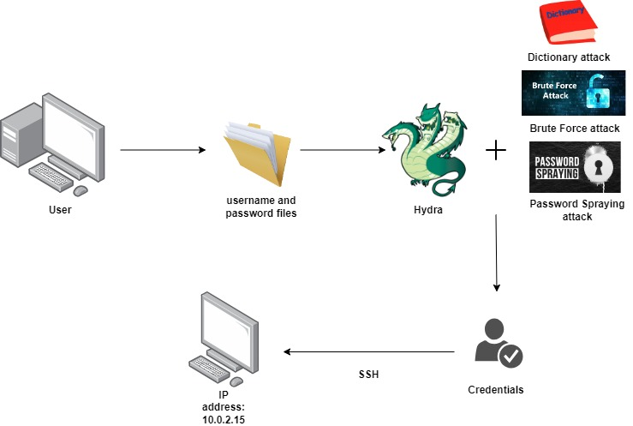
Visualization: Brute Force & Dictionary Attacks
Notes:
Slide 2, 3, 4 - Technical Background: These slides explain the technical background of the project. They cover any protocols, cryptographic concepts, or network diagrams that are used in the upcoming demonstration.
Additionally, this section of the presentation can include:
Why you selected the topic that you are presenting.
Steps you took to research this topic.
For example, this presentation covers what the protocol DHCP is, what the attack is, DHCP starvation, and a network diagram, as the following image shows:

Slide 10
Installation of each password cracker:
Hydra | sudo apt install hydra
Cain and Abel | http://www.oxid.it/cain.html
Rainbow Crack | sudo apt install rainbowcrack
John the Ripper | sudo apt-get install john -y
Notes:
This slide shows how to install and set up all four of the password cracking tools we went over, but we will be focusing on hydra and how it will be used to conduct the attack, as the following image shows:
Hydra already comes pre-installed in kali

Slide 11
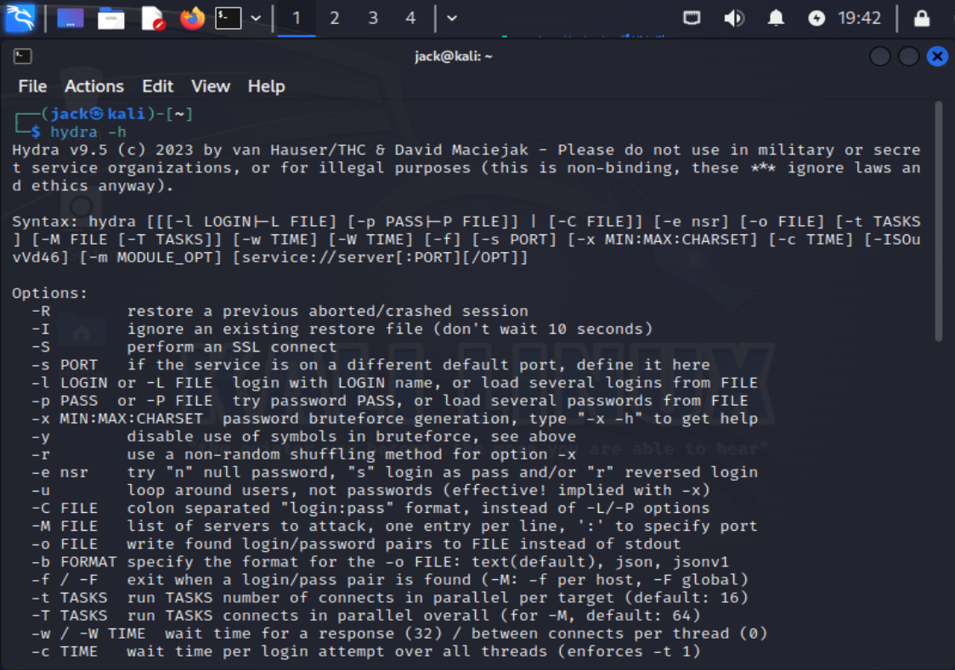

Slide 12
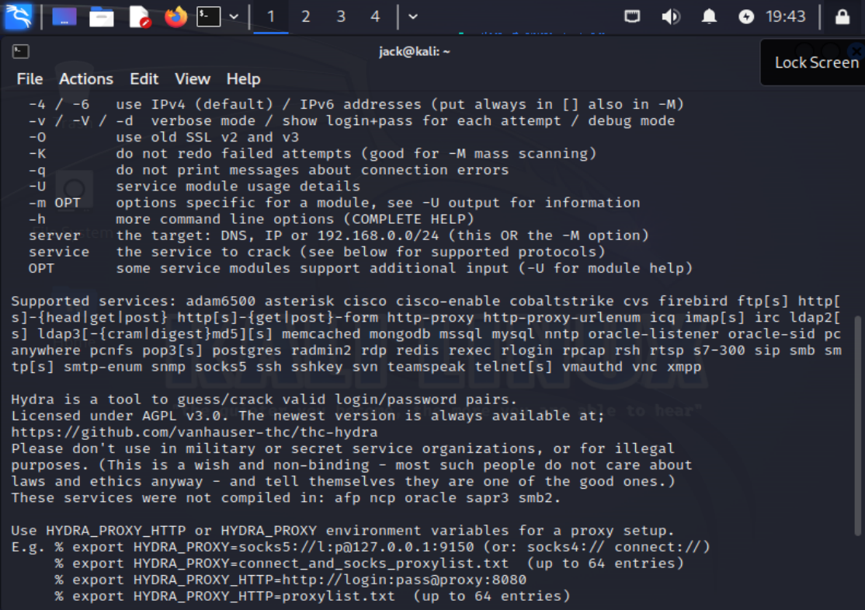

Slide 13
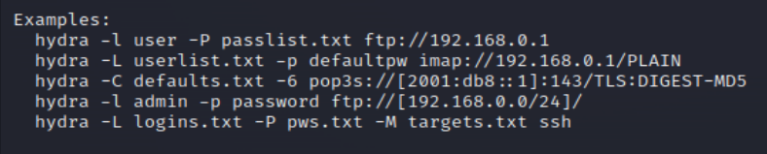
Examples of different Hydra commands

Slide 14

Hydra Kali Linux Demo
Notes:
First things first, we will open up our Kali virtual machine and login with our credentials.
Then open up our terminal and run an ifconfig in order to find out the IP address of the machine to see if we can work our way into a different user’s account.
From here, we can run hydra -h in order to see what sort of options are available to us, but for today, we will be using the -L and -P options.
We’ll also run an Nmap scan on the IP address to see what ports are potentially open and vulnerable. We can see here that port 22 is open for a potential ssh.
I run an ls -l command to show the two txt files: username.txt and lab.txt.
To show what is these files, we’ll go ahead and use the cat command to see that these are lists of usernames and passwords.
Let’s go ahead and use the hydra command with capital L with the username list and capital P with the password list for a brute force attack. Hydra will run and come back with both a username and password being admin and password1234. We’ll go ahead and test this with an ssh.
Next we’ll run a password spraying attack with capital L and the username list and using a lowercase p since we gained some information somewhere that the password was password1234.
This last demo will be a dictionary attack using our made up lab.txt password list against the username admin using a lowercase l and capital P.

Slide 15

Effects of the Attack
We were able to obtain the credentials of the admin and log in via ssh
From here we could create/delete files
Maintain access in the system
We could elevate root privileges
Change passwords and lock out users
Information could be gathered and leaked/sold

Slide 16

Mitigating Brute Force & Dictionary Attacks
Strong passwords!
Multi-Factor Authentication
Account Lockout policies
Rate Limiting
Password Hashing and Salting
Web application firewalls (WAF)
Software updates and patching
Notes:
If your presentation does not involve an attack, then this slide is not required.

Slide 18
References
http://repository.futminna.edu.ng:8080/jspui/bitstream/123456789/9652/1/A%20Review%20of%20Top%20Open%20Source%20Password%20Cracking%20Tools.pdf
https://resources.infosecinstitute.com/topics/hacking/password-cracking-using-cain-abel/
https://www.kali.org/tools/hydra/
https://www.kali.org/tools/rainbowcrack/
https://www.freecodecamp.org/news/crack-passwords-using-john-the-ripper-pentesting-tutorial/
https://www.techtarget.com/searchsecurity/tutorial/How-to-use-the-Hydra-password-cracking-tool
https://capec.mitre.org/data/definitions/55.html

Slide 19
References
https://www.youtube.com/watch?v=RyQL9AdxHqY
https://resources.infosecinstitute.com/topics/hacking/10-popular-password-cracking-tools/
https://resources.infosecinstitute.com/topics/hacking/popular-tools-for-brute-force-attacks/
chrome-extension://efaidnbmnnnibpcajpcglclefindmkaj/https://bpb-us-e1.wpmucdn.com/sites.psu.edu/dist/9/24816/files/2016/06/PasswordCracking.pdf
https://youtu.be/Y2fhWtZedTQ?si=4ftHjIb4IPkG6sPU

